Slide 1
Operating systems
Partitioning
Course #13

Slide 2
Introduction
A well-thought-out partitioning scheme is vital to optimizing the use of system resources. While it is technically possible to make post-installation changes to partitions, this may be challenging and require system down time.
Therefore, it is important to consider how the system will be used before you begin creating partitions.
Partitioning is necessary in order to optimally use the space that hard drives (hard disks) provide. A hard drive is like a completely empty building, with no internal walls or floors. As it is, such a building wouldn't be useful, but populating the building with walls and floors would provide the structure needed to make use of the building.

Slide 3
Introduction
There are three steps in the process of making and using partitions:
1. Divide the hard drive into partitions
2. Format the hard drive with a filesystem
3. Mount the filesystem onto the directory tree

Slide 4
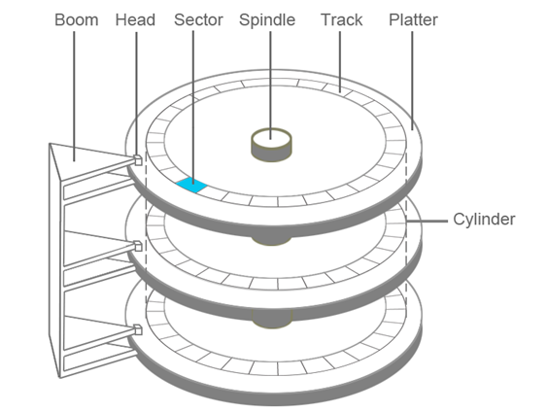
Introduction
A typical hard disk drive (HDD) consists of multiple platters, which store data in magnetic form. Heads are able to read and write on both sides of each platter. The platters are connected to the spindle and spin at the same speed. The boom moves back and forth, allowing each head to read from or write to the same location on each platter simultaneously.

Slide 5
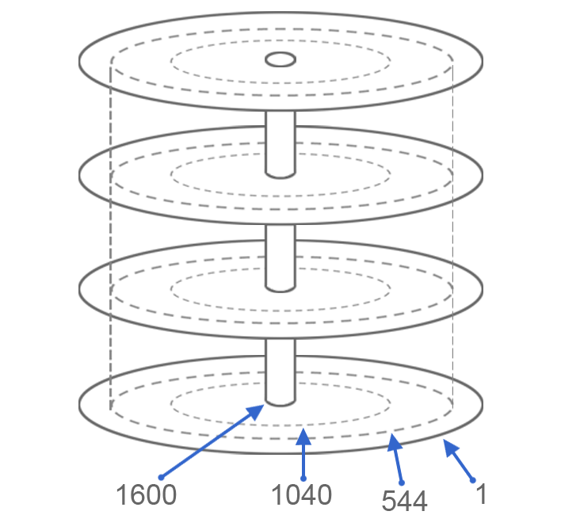
Introduction
One complete rotation around one side of a platter is called a track. The same track on both sides of all of the platters forms a cylinder.
A typical hard drive may have thousands of cylinders. Multiple consecutive cylinders can be assigned to a partition.
In the example below, the first partition would be from cylinder 1 to cylinder 544. The second partition would be from cylinder 545 to cylinder 1040. The last partition would be from cylinder 1041 to 1600.

Slide 6
Why Create Partitions?
As a rule, at least one partition needs to be created.
Regardless of the operating system, whether Linux, Microsoft Windows or Mac OSX, at least one single partition needs to be created because filesystems are stored within partitions, not entire hard disks.
Offering support for multiple operating systems
Some systems may contain Linux as well as Microsoft Windows operating systems; these are called dual boot systems. Because the filesystems that are used with Microsoft Windows are different than Linux, this requires multiple partitions.
Home Directories
A separate partition for the user home directories is common and typically provides many advantages, including:
• It is easier to backup or restore an entire filesystem than it is to manage each user's home directory. Recall that each partition has a separate filesystem.
• When home directories are separated from the root filesystem, upgrades of the operating system can be performed much more safely and efficiently.
• Filesystems can have features enabled on them, such as disk quotas. A disk quota allows the administrator to limit how much space a user uses in a filesystem. Being able to create a disk quota for the home directories that doesn't affect the rest of the operating system can be an advantage.

Slide 7
Why Create Partitions?
Common Writable Directories
Some directories, such as the /tmp and /var/tmp directories, are world writable. This means that any user can store files in these directories without any limitations by default. Unfortunately, that can cause problems if these directories are not placed on separate filesystems.
If the /tmp and /var/tmp directories are not mount points, then files placed in these directories will go on the same partition as the / filesystem. If a user creates a very large file, then he could end up filling up the entire / filesystem. This would make the operating system unusable by all other users (except the root user for whom some space is reserved).
Separating the /tmp and /var/tmp directories allows the administrator to enable disk quotas to limit how much space can be used by each user in those directories. Even if no quotas are put into effect, having directories on a separate partition means if a regular user fills up the partition(s) /tmp or /var/tmp are located on, the root filesystem or other critical filesystems are not affected.

Slide 8
Why Create Partitions?
Security
Using separate partitions may be done for security. Having files in a separate partition is safer than if they were a part of a larger root filesystem because there is less risk of corruption.
When using a separate filesystem, there will be separate inodes and data blocks, so there is less chance that they might be overwritten.
Sometimes a collection of files, perhaps old databases, need to be stored but shouldn't be modified. By placing them on a separate filesystem, that partition can be mounted as read-only to prevent any alteration.
Heavily Active
If running out of space is a concern due to heavy activity within a directory, it may be desirable to have it mounted on a separate partition. This is often the case for directories like the /var/log directory where the system adds log file data on a regular basis.
When system processes (as opposed to regular users) write to the disk, quotas are not usually used to limit the space. Instead, these types of directories are mounted on separate filesystems so that if they fill up then it won't fill up the / filesystem. While this may be bad because log files aren't generated, it is better than filling up the / filesystem and making the operating system unusable for regular users.

Slide 9
Partition Naming
In order to distinguish one partition from another, each partition is given a unique name. Recall that everything in Linux is treated as a file, so names of devices such as drives and partitions are stored in the /dev directory.
There are two different types of drive interfaces:
/dev/sd* - Drives that start with sd are either SATA (Serial ATA), SCSI (Small Computer System Interface) or USB drives. The first sd drive is called /dev/sda, the second is called /dev/sdb, etc.
/dev/hd* - Drives that start with hd are PATA (Parallel ATA), also known as IDE (Integrated Drive Electronics) drives. The first hd drive is called /dev/hda, the second is called /dev/hdb, etc.
How can I see if my disk is a SSD or a HD?
Use: cat /sys/block/sda/queue/rotational
1 – means HD
0 – means SSD

Slide 10
Partition Naming
Partitions are then given names based on the drive they reside on. A number is added to the end of the drive name to distinguish one partition from another.
For example, the partitions located on sda would be named sda1, sda2, etc. Partitions located on drive sdb would be sdb1, sdb2, etc.
Test the following commands:
cd /dev ; ls sd*
df –kh
sudo fdisk –l | more
top
htop

Slide 11
Partition Limitations
Historically, most PCs are limited by their compatibility with a Master Boot Record (MBR) as to the number of partitions that they can use. Recall that the MBR is usually contained within the first sector or 512 bytes of the disk and contains a boot loader program as well as the partition table. The partition table contains the definition of each partition on the hard drive, including which cylinder it starts and ends on and how big it is.
Traditional disks using MBR partitioning can have a maximum of four primary partitions . In the next slide, for example, on a traditional SATA drive, four partitions can be created with device names of /dev/sda1, /dev/sda2, /dev/sda3, and /dev/sda4:

Slide 12
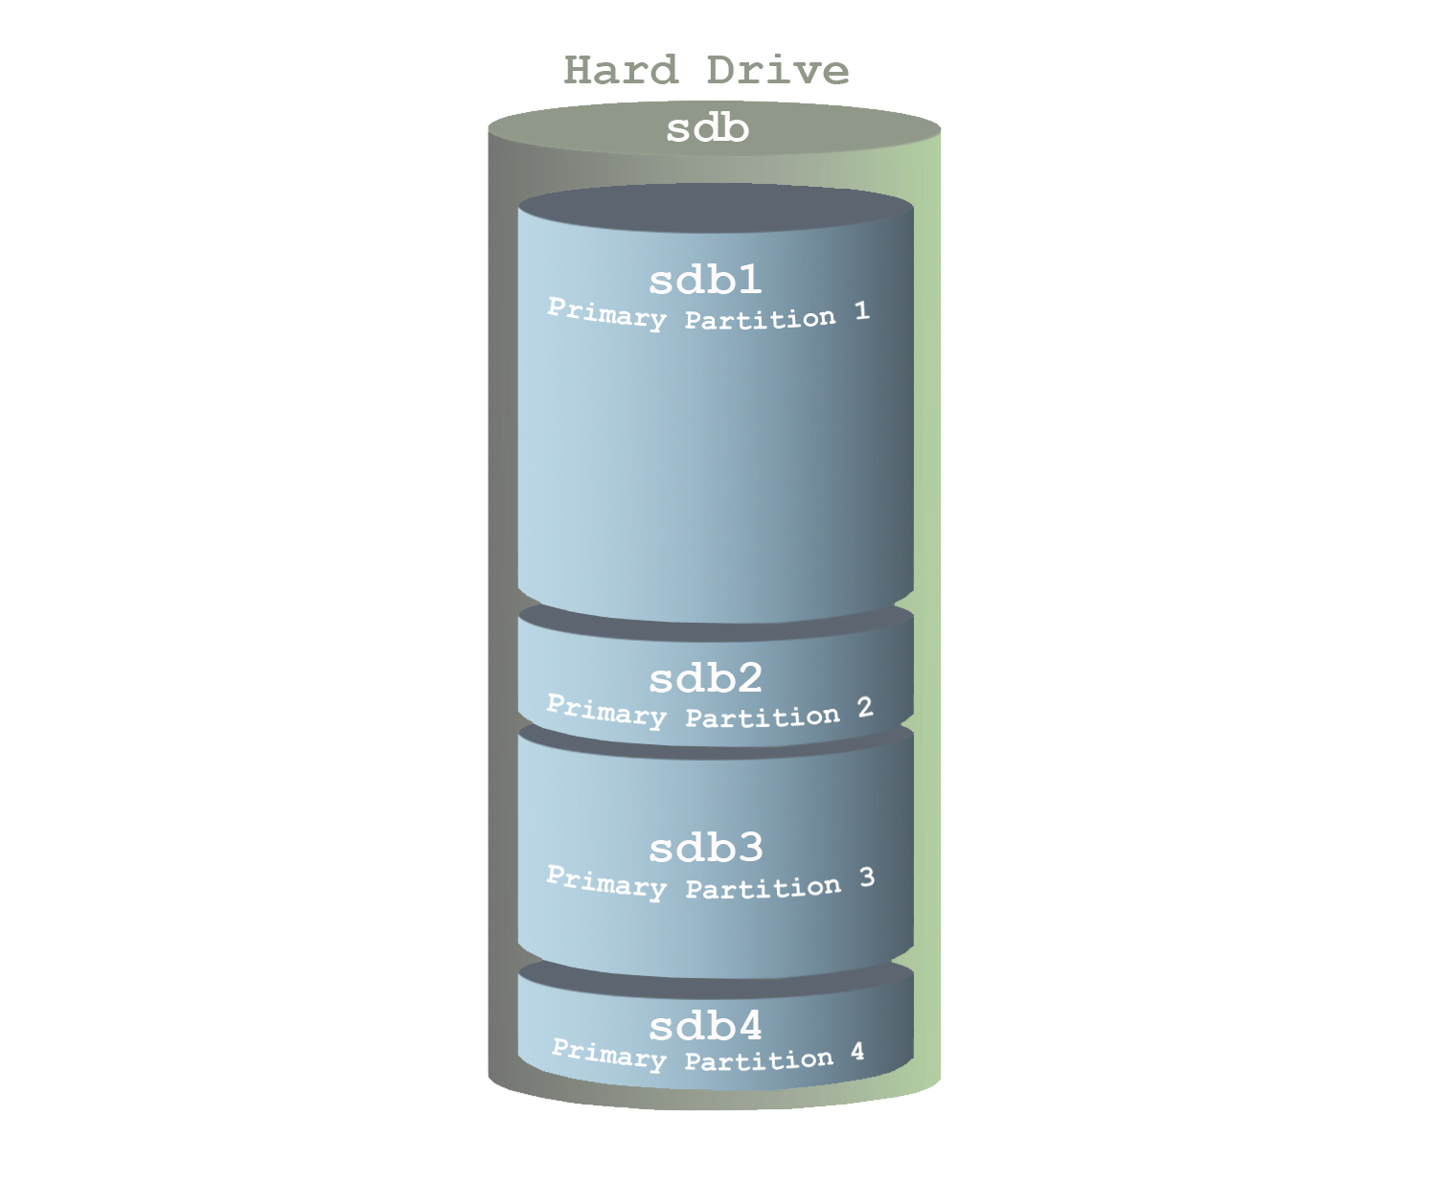
Partition Limitations

Slide 13
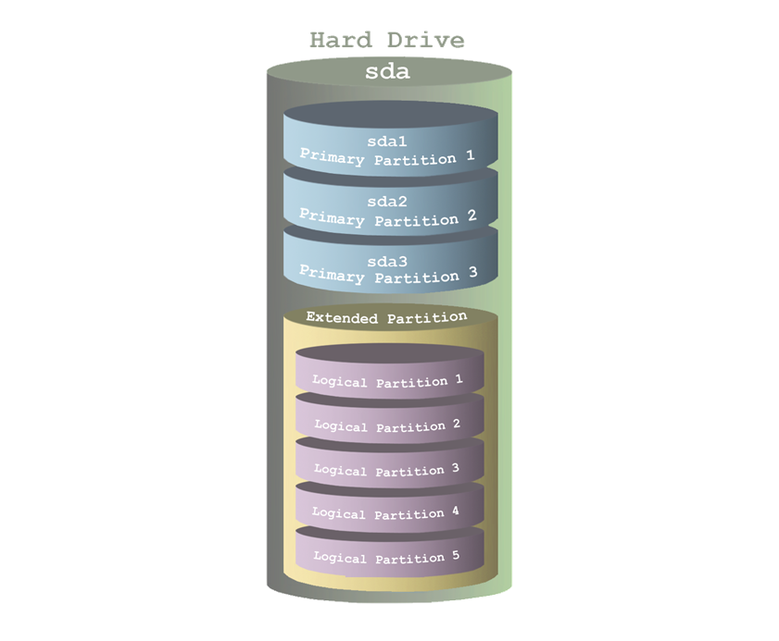
Partition Limitations
Modern hardware allows the administrator to make one of the four partitions an extended partition.
An extended partition acts like a container for additional partitions called logical partitions.
The /dev/sda4 partition is an extended partition. The only thing that is placed in this extended partition are additional partitions, logical partitions.
Depending upon the type of hard disk and kernel configuration, Linux can access a maximum of either 15 or 63 total partitions when extended partitions are used.

Slide 14
Partition Limitations
Recently, administrators have begun to use a different type of partitioning technology known as Globally Unique Identifier (GUID) designed to replace traditional MBR partitioning.
This new partitioning is available if the system supports the Unified Extensible Firmware (UEFI).
The GUID Partition Table (GPT) supports much larger disks with up to 9 ZB in size. Extended and logical partitions are not used with GPT; instead all partitions are the same and GPT supports a maximum of 128 partitions per disk.
In addition to MBR and GPT partition tables, there are other methods for dividing up the disk, including Berkeley Software Distribution (BSD) Unix Labels, Apple Partition Maps, and others.

Slide 15
GUID/GPT (Globally Unique Identifier - GUID Partition Table)
GPT vs. MBR
Characteristics | MBR | GPT
Maximum no of partitions | 4 primary (or 3 + 1 extended) | 128 partitions (on Windows)
Disk – max dimension | 2 TB | Theoretically: 9.4 ZB (zettabytes)
Redundancy | No | Yes – it has backup copies of the table
Error checking | No | Yes – with CRC32
BIOS compatible | Yes | No (only UEFI compatible)
Needs special partition | No | Yes –EFI partition (FAT32)

Slide 16
The filesystem
In order to place files and directories on a partition, a filesystem needs to be created. This is accomplished by formatting the partition.
A filesystem provides the operating system with a way to organize the files and directories, as well as store information about files, such as the permissions of the files, the owner of the files and the file type.
Each file will have an entry in the filesystem database, similar to a library catalog, although the database is often referred to as a table. Metadata about the file will be contained in this entry, which is everything about the file except for its contents.
The entry also includes a unique identification number for the file, called an inode number and pointers (or links) that inform the operating system where in the filesystem (where on the hard drive) the file's data is stored.

Slide 17
Common filesystem types
• ext2: Second Extended Filesystem
Advantages: Works well with small and solid-state disk filesystems.
Disadvantages: No journaling capability, making it susceptible to data loss in the event of power loss.
• ext3: Third Extended Filesystem
Advantages: Can be upgraded from existing ext2 filesystem without data loss. This filesystem performs journaling, which allows for data recovery after a crash.
Disadvantages: Writes more to disk than ext2 because of journaling, making it slower. Does not support very large filesystems.
• ext4: Fourth Extended Filesystem
Advantages: Support for very large disk volumes and file sizes. Can operate with or without a journal. Backwards compatible with ext3 and ext2.
Disadvantages: Not a huge improvement over ext3. No dynamic inode creation.
• reiserfs: The Reiser Filesystem
Advantages: The first journaling filesystem for Linux. Works efficiently with small files.
Disadvantages: Development of this version has ceased with its successor Reiser4 proceeding slowly without help from the founder.

Slide 18
Common filesystem types
• xfs: Extents Filesystem
Advantages: Works very efficiently with large files. Compatible with the IRIX operating system from SGI. Announced to be the default filesystem for RHEL 7.
Disadvantages: The filesystem cannot be shrunk.
• vfat: File Allocation Table
Advantages: Supported by almost all operating systems. Commonly used for removable media.
Disadvantages: Unable to support very large disks or files. Microsoft's intellectual property claims.
• iso: ISO 9660
Advantages: The International Organization for Standardization standard for optical disc media that is supported by almost all operating systems.
Disadvantages: Multiple levels and extensions complicate compatibility. Not designed for rewritable media.
• udf: Universal Disc Format
Advantages: Designed to replace ISO 9660 and adopted as the standard format for DVDs by the DVD Consortium.
Disadvantages: Write support is limited to support revision 2.01 of the standard.

Slide 19
Summary of key terms
Filesystem: A database system used to organize files.
Table: The database where the filesystem stores its information.
Metadata: File attributes like ownership, timestamps, data block locations, etc.
Inode: A unique number given to each file on the filesystem.

Slide 20
Summary of key terms
About filesystem journaling:
As files are changed, metadata is not initially stored on the hard drive, but rather in memory. This speeds up the filesystem as writing these changes to the hard drive for every single file change would result in a lot of hard drive writes.
At specific intervals, this metadata is written to the hard drive in large chunks; this process is called syncing. Normally this poses no problems, but if the system were to crash or lose power before a sync occurred, all of that metadata would be lost.
A filesystem recovery program, like the fsck command, can often resolve these problems, but this can take quite a bit of time for large filesystems.
A journal limits filesystem recovery. For every change made to a file, a journal entry is stored on the hard drive. While this does increase filesystem writes, a journal entry has much less impact on hard drive performance that writing the metadata directly to the hard drive for each file change.
In a nutshell, a journal filesystem aids in recovering corrupted filesystems while allowing for reduced hard drive writes.

Slide 21
Linux Filesystem Components
The term "Linux filesystem" often refers to the ext2/ext3/ext4 family of filesystems. While there are differences between these filesystems, they are similar enough when it comes to core filesystem components:
• Superblock: At the beginning of the filesystem is an area called the superblock. This area is used to store important information about the filesystem, including the size of the filesystem, the type of filesystem and which data blocks (where file data is stored) are available. The superblock is a key component of the filesystem; a corrupted superblock would make the filesystem inaccessible.
• Group Block: The filesystem is divided into smaller sections called groups. The group block serves to hold data about the group. Each group block also contains a backup copy of the superblock.
• Inode Table: Each file is assigned a unique inode number for the filesystem. This inode number is associated with a table that stores the file's metadata.

Slide 22
Physical vs. Virtual Filesystems
In case of Windows we use drive letters. (see disk management as an example)
In Linux there are no drive letters. Instead, each partition is assigned a device file name, like:
• /dev/sda1, /dev/sda2, etc. for partitions on SATA, SCSI and USB devices
• /dev/hda1, /dev/hda2, etc. for partitions on PATA/IDE devices
Users do not access the files that are stored on these partitions by directly using these device file names. After all, it's not convenient to remember what files are located on /dev/sda1 versus what files are stored on /dev/sda2. Instead, these device files are merged into the directory structure by mounting the partition's filesystem under a directory tree.

Slide 23
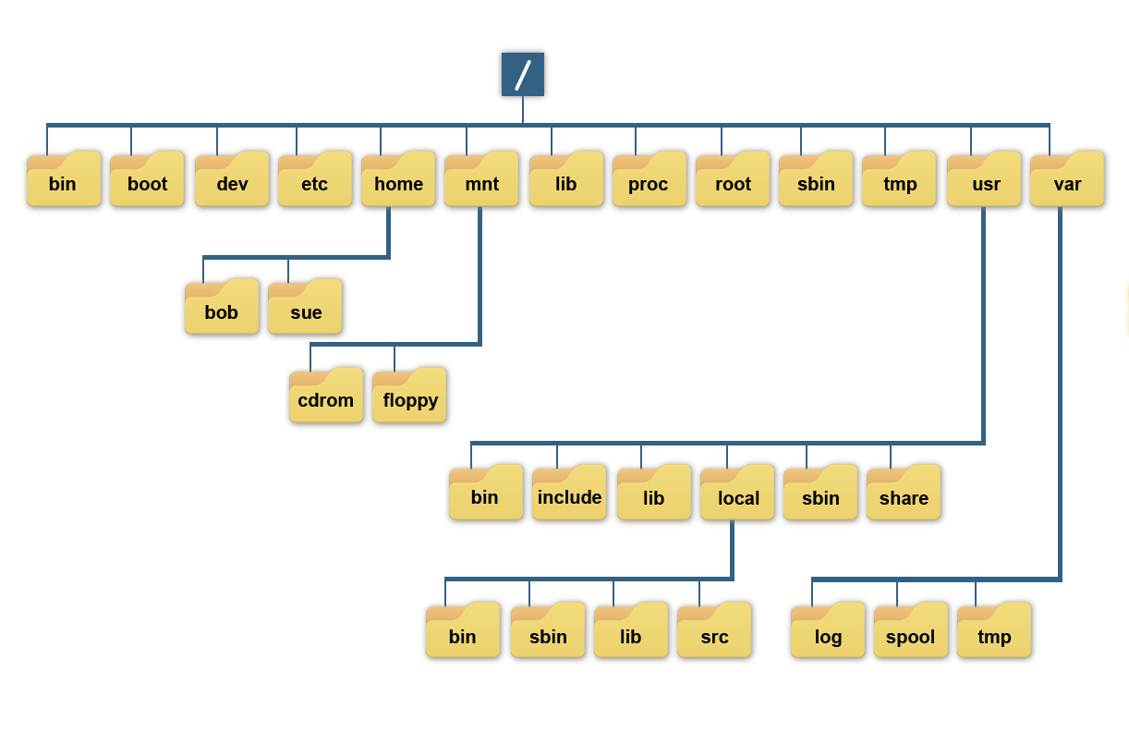
Virtual Filesystems

Slide 24
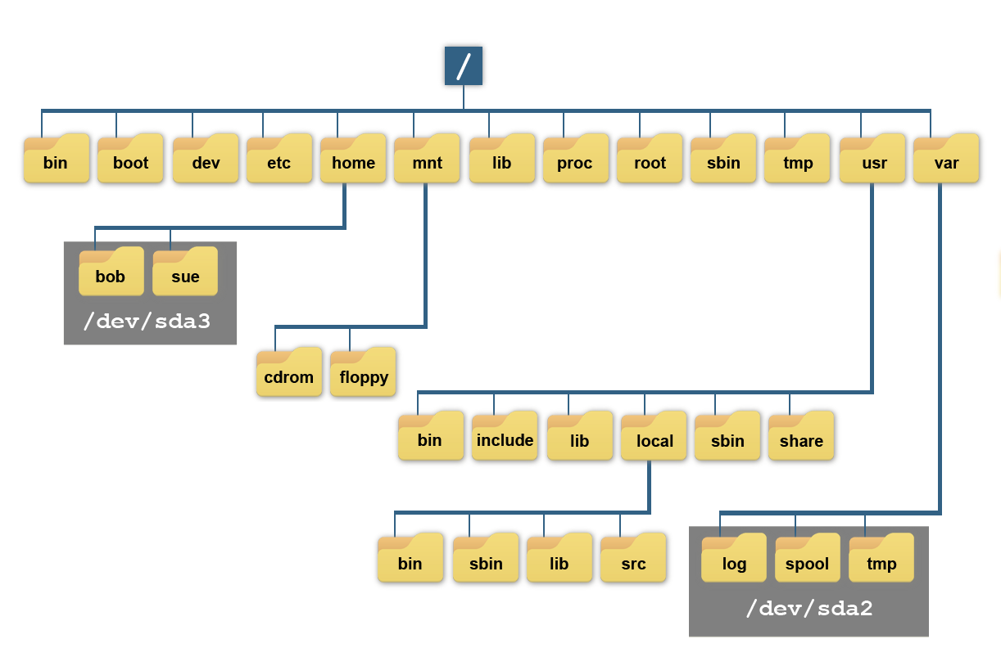
Conclusions (2)
All of the files under the /home directory are really stored in the filesystem that is on the /dev/sda3 partition. All of the files under the /var directory are stored in the filesystem that is on the /dev/sda2 partition. This makes /home and /var mount point directories. The / directory is also a mount point directory, likely for the filesystem on the /dev/sda1 partition.
The process of placing a filesystem under a mount point is called mounting. This is accomplished either automatically at boot or manually with the mount command.

Slide 25
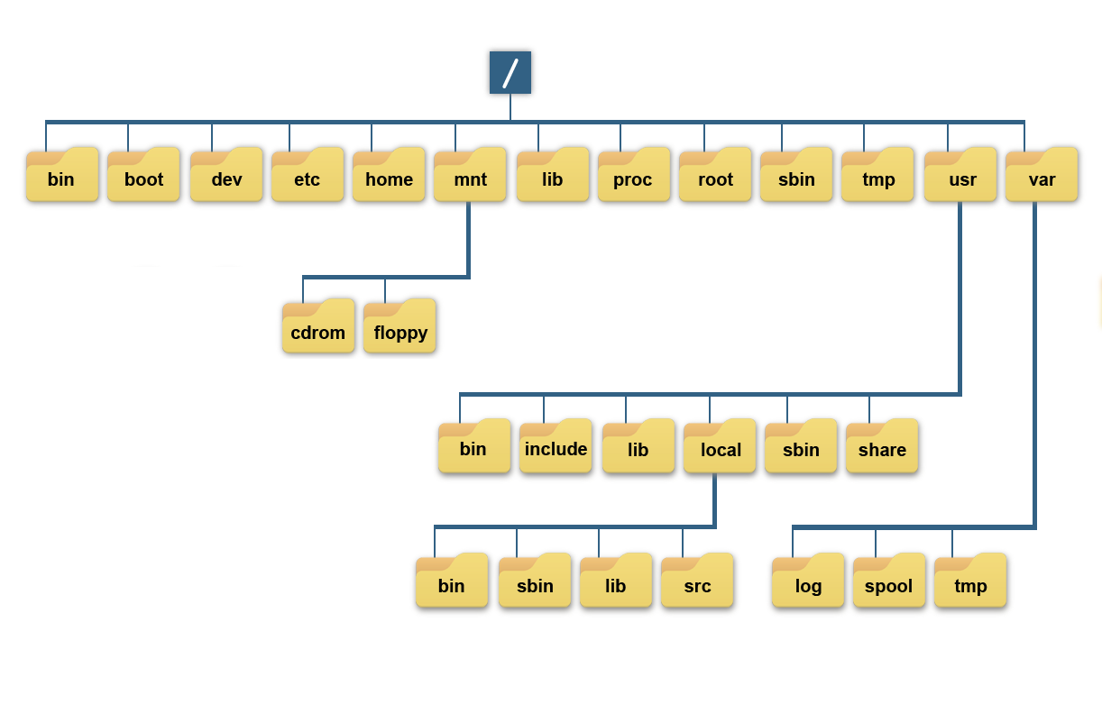
Virtual filesystems
If the administrator were to unmount the /dev/sda3 filesystem from the previous example, then the virtual filesystem would look like the following:

Slide 26
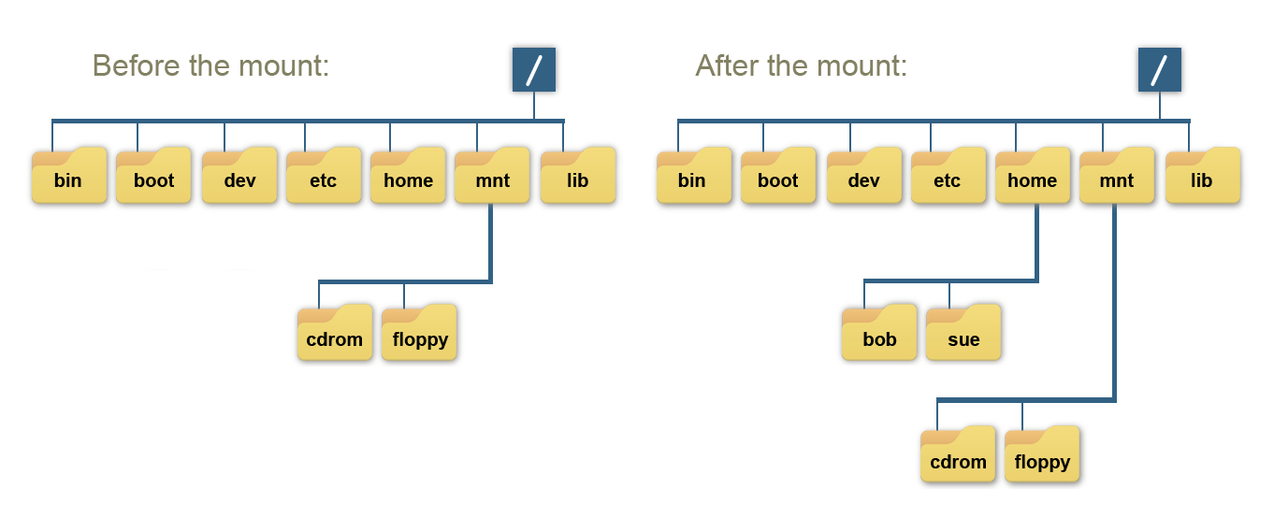
Virtual filesystems
Notice that now there is nothing under the /home directory. This is common because a mount point directory should be empty, as anything contained in a mount point directory will be inaccessible after the unmount. The /dev/sda3 filesystem is mounted under the /home directory, then the bob and sue directories would again be available.

Slide 27
Key terms summary
/ (root) filesystem
The filesystem that is contained on the same partition on which the root directory is located, and it is the filesystem on which all the other filesystems are mounted as the system is booted up.
/boot filesystem
The directory containing everything required for the boot process except for configuration files not needed at boot time.
/home filesystem
Typically the parent directory for individual user home directories. Each users personal files may be stored within the user subdirectories along with user specific configuration files.
/var filesystem
The directory containing variable data like system logging files, mail and printer spool directories, and transient and temporary files.
MBR
The Master Boot Record (MBR) represents the first 512 bytes of a storage device. It contains an operating system bootloader and the storage device's partition table.

Slide 28
Key terms summary
fsck
Command used to check and optionally repair one or more Linux file systems. If no filesystem is specified with the command, fsck will check all filesystems in the /etc/fstab file by default.
mount points
A connection between a partition’s file system and a folder allowing you to access the files on the partition.
parted
A disk partitioning and partition resizing utility. It allows an administrator to destroy, create, resize, move, and copy ext2, linux-swap, FAT, FAT32, and reiserfs partitions.
partitions
The logical division of the available space on a hard drive into one or more sections that can be accessed independently of one another.
swap space
Used when the amount of physical memory (RAM) is full. If the system needs more memory resources and the RAM is full, inactive pages in memory are moved to the swap space.

